Slide 1
Team Based Learning
Week 1
We form groups of 3-4 students,
Each group will discuss the question projected on the screen
After a few minutes of discussion, each group will signal with the A,B,C,D,E cards which they consider the most correct answer.
Followed by a short discussion of the reasoning.

Slide 2
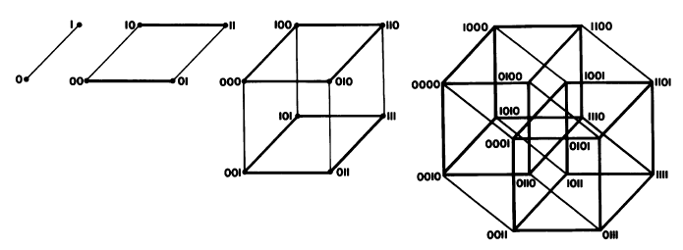
Sequence Space
Figure from Eigen et al. 1988 illustrating the construction of a high dimensional sequence space. Each additional sequence position adds another dimension, doubling the diagram for the shorter sequence. Shown is the progression from a single sequence position (line) to a tetramer (hypercube). A four (or twenty) letter code can be accommodated either through allowing four (or twenty) values for each dimension (Rechenberg 1973; Casari et al. 1995), or through additional dimensions (Eigen and Winkler-Oswatitsch 1992).
Eigen, M. and R. Winkler-Oswatitsch (1992). Steps Towards Life: A Perspective on Evolution. Oxford; New York, Oxford University Press.
Eigen, M., R. Winkler-Oswatitsch and A. Dress (1988). "Statistical geometry in sequence space: a method of quantitative comparative sequence analysis." Proc Natl Acad Sci U S A 85(16): 5913-7
Casari, G., C. Sander and A. Valencia (1995). "A method to predict functional residues in proteins." Nat Struct Biol 2(2): 171-8
Rechenberg, I. (1973). Evolutionsstrategie; Optimierung technischer Systeme nach Prinzipien der biologischen Evolution. Stuttgart-Bad Cannstatt, Frommann-Holzboog.

Slide 3

How many different protein sequences are possible based on simple combinatorics?
Assume that a sequence is 50 amino acids long and that for each position all 20 aa are possible (obviously unrealistic, one hardly would have a protein with 20 tryptophanes in a row). How many different sequences are possible?
4¹⁵⁰ different sequences are possible (each aa is encode by a triplet of nucleotides) = 2.0•10⁹⁰
150⁴ = 506,250,000
20⁵⁰ different sequences are possible = 1.13•10⁶⁵
50²⁰=9.5•10³³

Slide 4
If one defines sequence space as a multi-dimensional space, where each position in a sequence corresponds to one dimension; and assuming a sequence length of 100 amino acid positions, how many amino acid substitutions are maximally necessary to get from any one point in this sequences space to any other point?
The sequence space in this case has 20¹⁰⁰ points and the maximum distance would the connection that goes through each of these points.
The maximum would be one substitution per site; i.e., 100 in total, to get from any point in sequence space to any other point.
The maximum number step cannot be calculated in this case. The combinatoric sequence space contains about 10⁴⁵ more particles that there are elementary particles in the universe. The calculation of the maximal number of steps involves the factorial of this number, which is beyond what can be done in a computer.

Slide 5
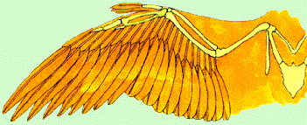
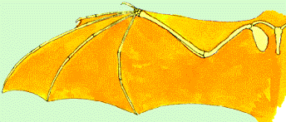

The bird wing and the wing of a bat
are paralogous structures that evolved through duplication of body segments
are homologous
are an example of convergent evolution and therefore not homologs.

Slide 6
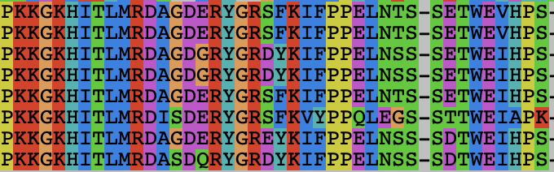

Sequence similarity versus homology
Two sequences in a multiple sequence alignment align nicely over their whole length and they are 55% identical, and 68% similar*
This level of similarity is sufficient to claim that the complete sequences are homologous over their entire length.
This means that the sequences are 55% homologous
This means that the sequences are 68% homologous
This level of similarity is frequently observed as the result of convergent evolution
* 68 % of the sites are either identical or represent a conservative substitution, i.e. replacement of an aa with a functionally similar amino acid

Slide 7
How many different protein sequences are possible base on simple combinatorics?
Assume that a sequence is 50 amino acids long and that for each position all 20 aa are possible (obviously unrealistic, one hardly would have a protein with 20 tryptophanes in a row). How many different sequences are possible?
4¹⁵⁰ different sequences are possible (each aa is encode by a triplet of nucleotides) = 2.0•10⁹⁰ This is the number of possible nucleotide sequences, but the genetic code is redundant, different triplets of nucs encode the same aa.
150⁴ = 506,250,000 This uses the wrong formula – possibilities pos 1 • possibilities pos 2 ...
20⁵⁰ different sequences are possible = 1.13•10⁶⁵
50²⁰=9.5•10³³ This uses the wrong formula

Slide 8
If one defines sequence space as a multi-dimensional space, where each position in a sequence corresponds to one dimension; and assuming that one has a sequence length of 100 amino acid positions, how many amino acid substitutions are maximally necessary to get from any one point in this sequences space to any other point?
The sequence space in this case has 20¹⁰⁰ points and the maximum distance would the connection that goes through each of these points.
The maximum would be one substitution per site; i.e., 100 in total, to get from any point in sequence space to any other point.
The maximum number step cannot be calculated in this case. The combinatoric sequence space contains about 10⁴⁵ more particles that there are elementary particles in the universe. The calculation of the maximal number of steps involves the factorial of this number, which is beyond what can be done in a computer.

Slide 9
The bird wing and the wing of a bat
are paralogous structures that evolved through duplication of body segments
are homologous
are an example of convergent evolution and therefore not homologs.

Slide 10
Sequence similarity versus homology
Two sequences in a multiple sequence alignment align nicely over their whole length and they are 55% identical, and 68% similar*
This level of similarity is sufficient to claim that the complete sequences are homologous over their entire length.
This means that the sequences are 55% homologous
This means that the sequences are 68% homologous
This level of similarity is frequently observed as the result of convergent evolution
* 68 % of the sites are either identical or represent a conservative substitution, i.e. replacement of an aa with a functionally similar amino acid

